Slide 1
Introduction to missing data imputation
Antonio Liguori – 19. March 2023

Slide 2


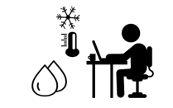


Introduction
Internet of things
Human –
building interaction
Big data analytics
Industry 4.0
Buildings
Artificial intelligence

Slide 3
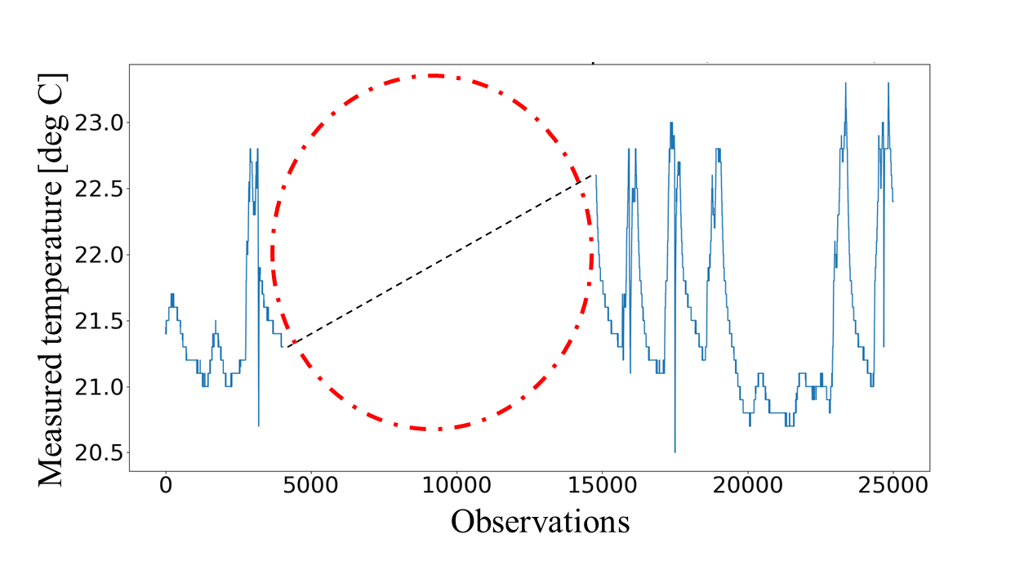
Introduction
Missing data are commonly observed in building energy management systems
Missingness might occur for various reasons (e.g. sensor malfunctioning, network issues)
Fig. 1. Trend of the indoor air temperature data for one office in the EON building.

Slide 4
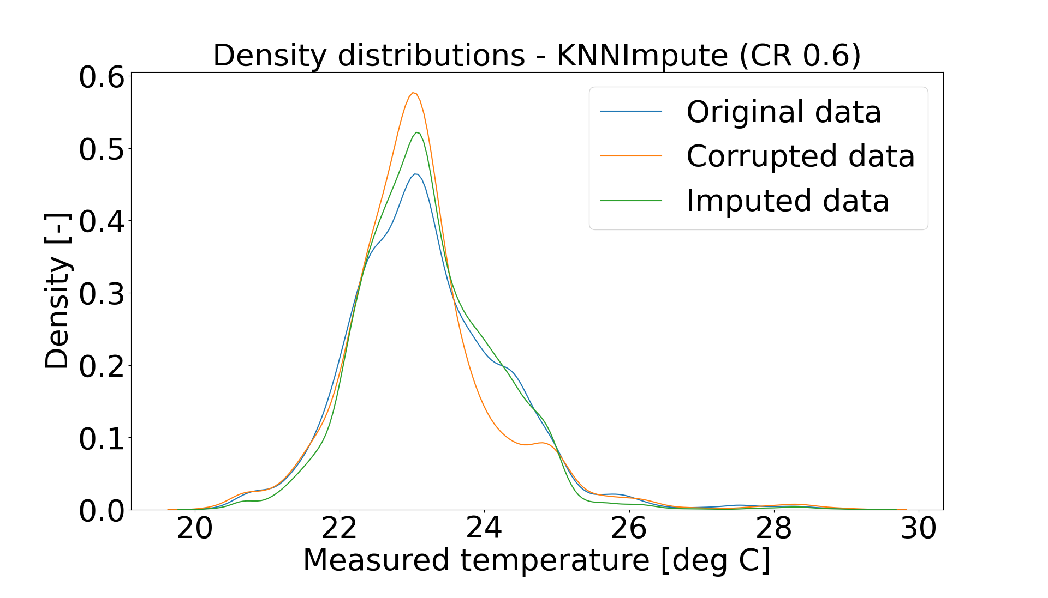
Introduction
Missing data can lead to biased and inaccurate analysis
Handling incomplete datasets is a tedious task
Imputation, i.e., the process of replacing missing / corrupted data with substitute values
Fig. 2. Density distributions of a room temperature dataset in case of real, missing /corrupted and imputed values.

Slide 5
The imputation problem

Slide 6
The imputation problem
Corruption rate (CR), i.e., the number of missing components over the total number of existing and missing components
Continuous missing, i.e., components are missing according to a systematic pattern
Random missing, i.e., components are missing completely at random

Slide 7
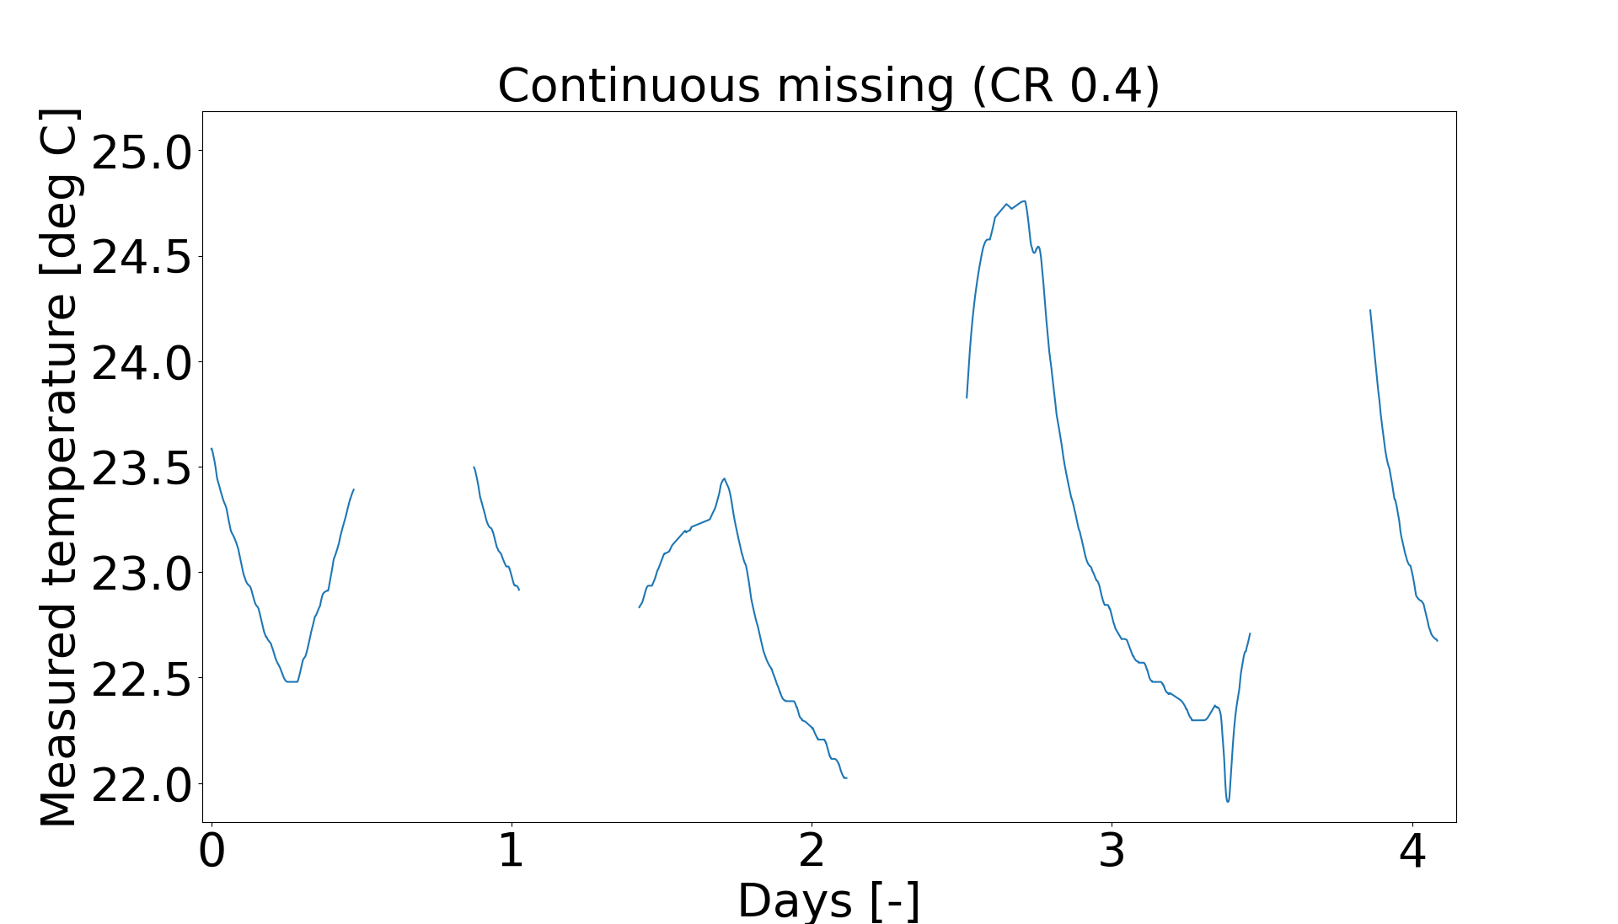
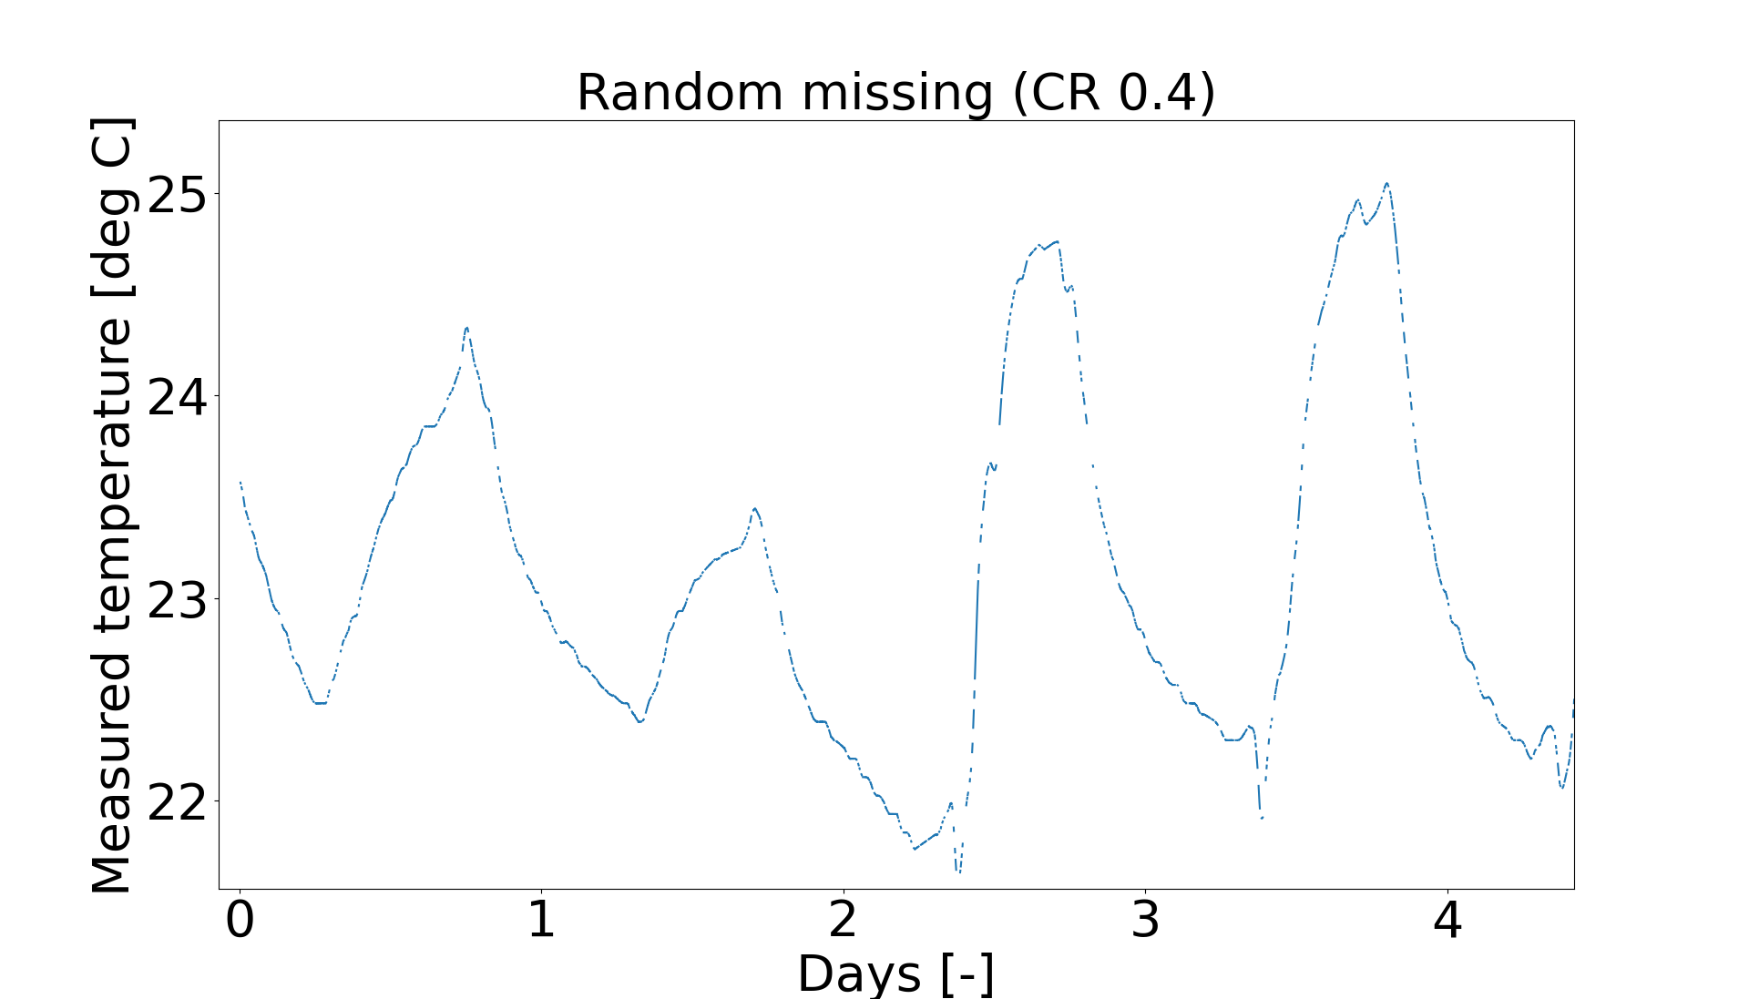
The imputation problem
The distance between the two last known values is generally smaller in the random missing scenarios
Simplified statistical approaches are usually a good fit to random missing
More advanced solutions are usually required for continuous missing
Fig. 3. Continuous and random missing scenarios for four consecutive days with room temperature measurements.

Slide 8
Imputation techniques

Slide 9
Imputation techniques
Statistical approaches
Machine learning

Slide 10
Imputation techniques
Statistical approaches
Linear interpolation
Mean operation
Machine learning
KNNimpute
MissForest

Slide 11
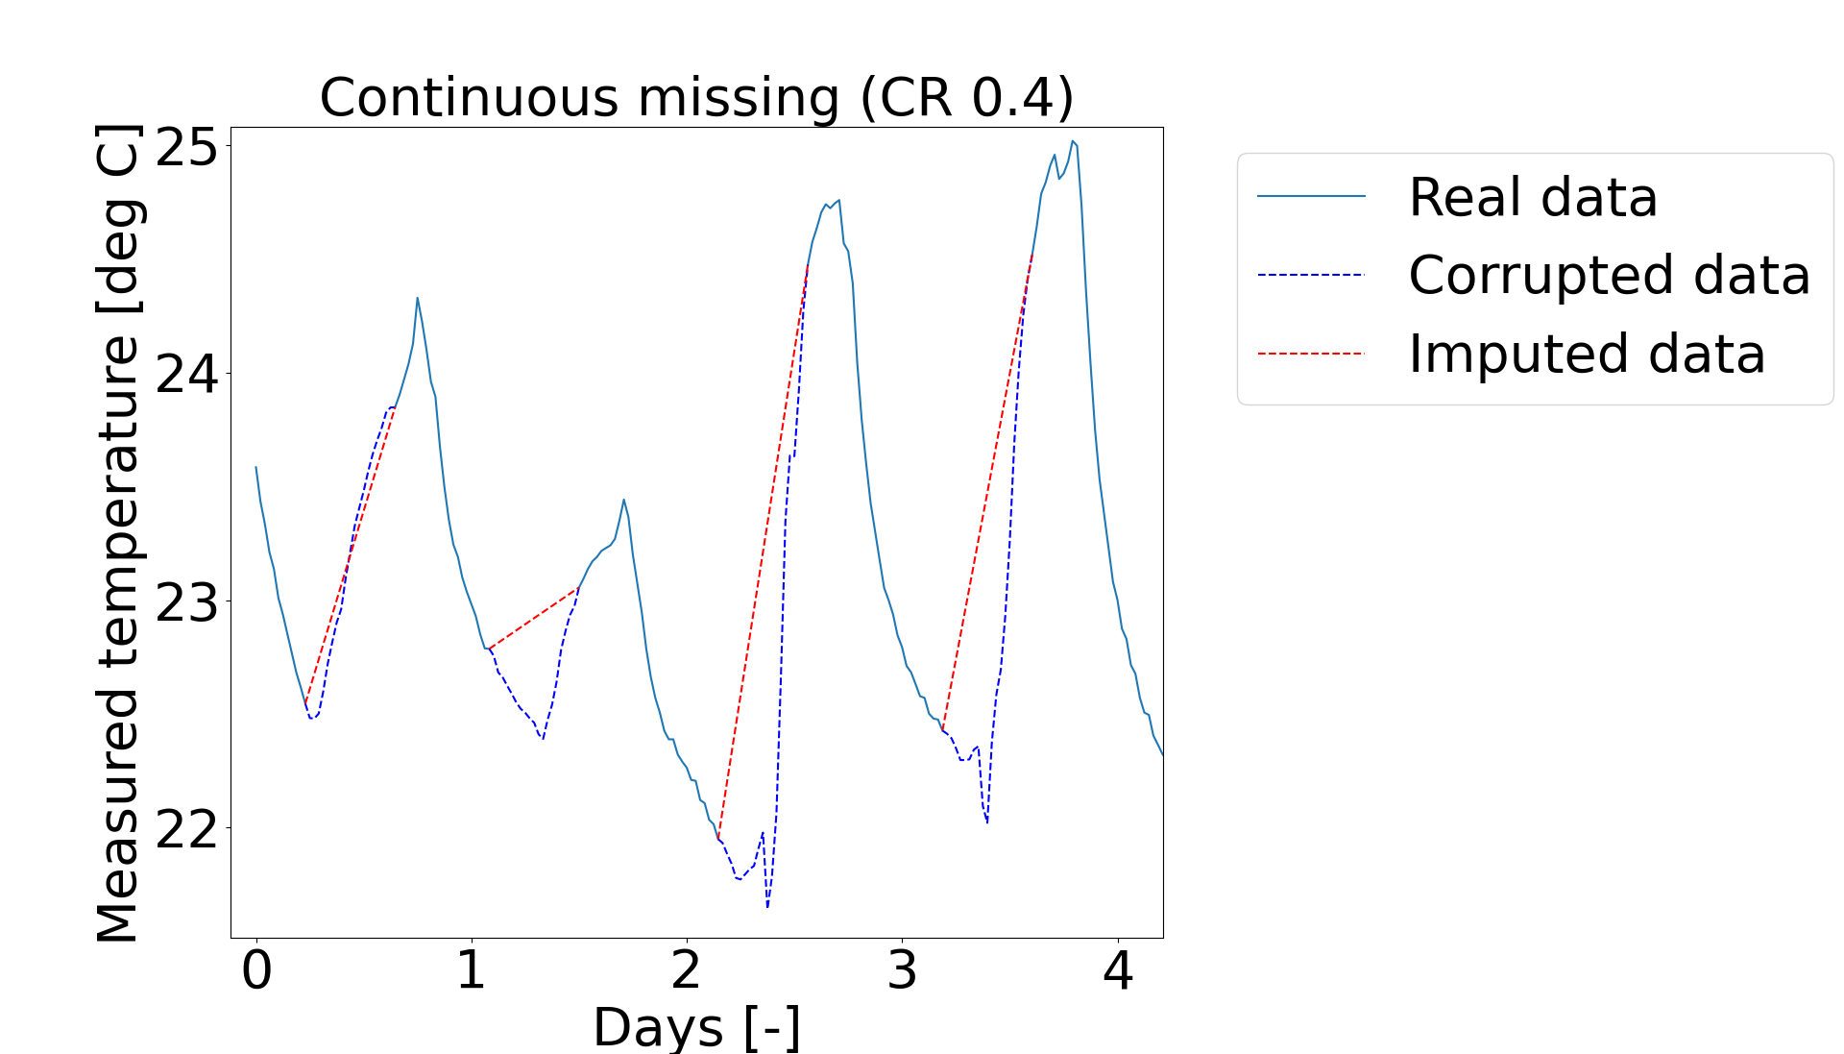
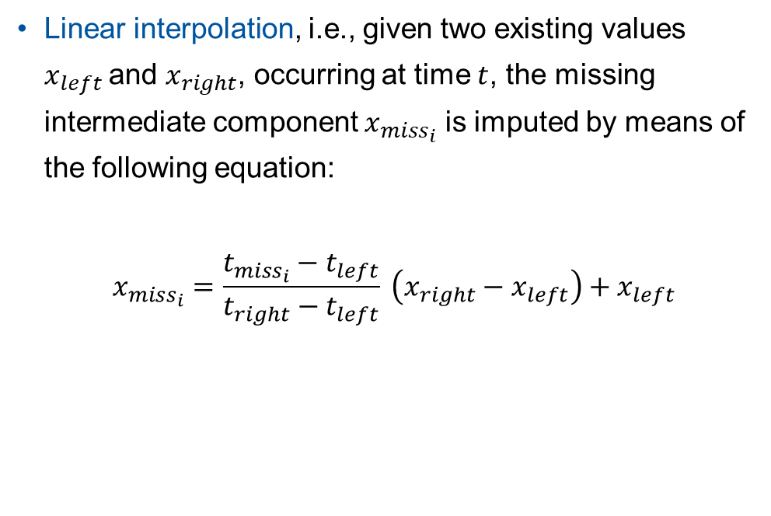
Imputation techniques - Linear interpolation
Linear interpolation, i.e., given two existing values $x_{left}$and $x_{right}$, occurring at time $t$, the missing intermediate component $x_{miss_{i}}$ is imputed by means of the following equation:
$$x_{miss_{i}}=\frac{t_{miss_{i}}−t_{left}}{t_{right}−t_{left}} \left(x_{right}−x_{left}\right)+x_{left}$$
Fig. 4. Imputation with linear interpolation.

Slide 12
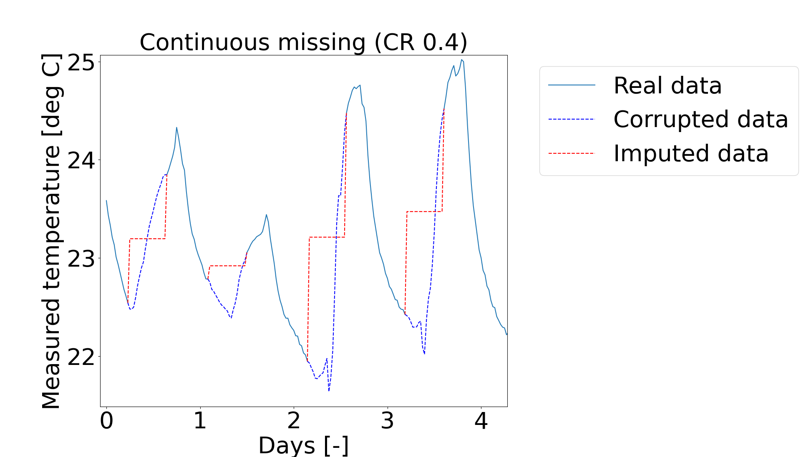
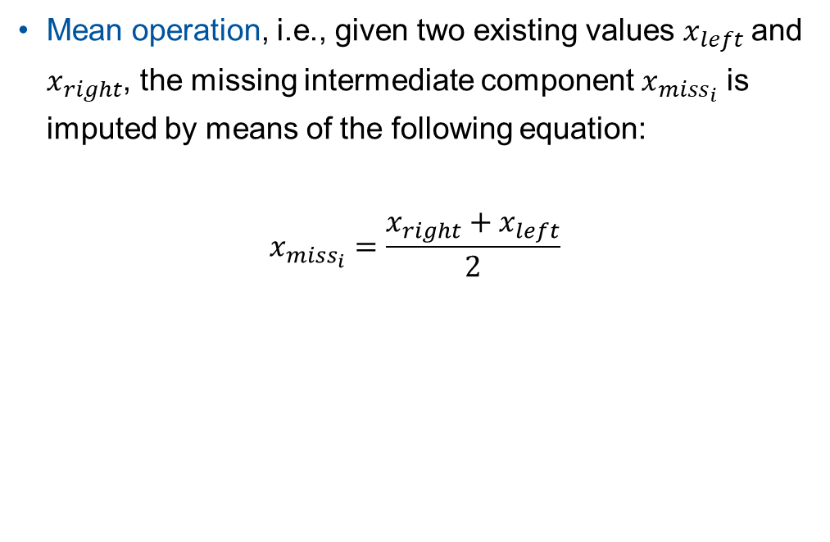
Imputation techniques - Mean operation
Mean operation, i.e., given two existing values $x_{left}$and $x_{right}$, the missing intermediate component $x_{miss_{i}}$ is imputed by means of the following equation:
$$x_{miss_{i}}=\frac{x_{right}+x_{left}}{2}$$
Fig. 5. Imputation with mean operation.

Slide 13
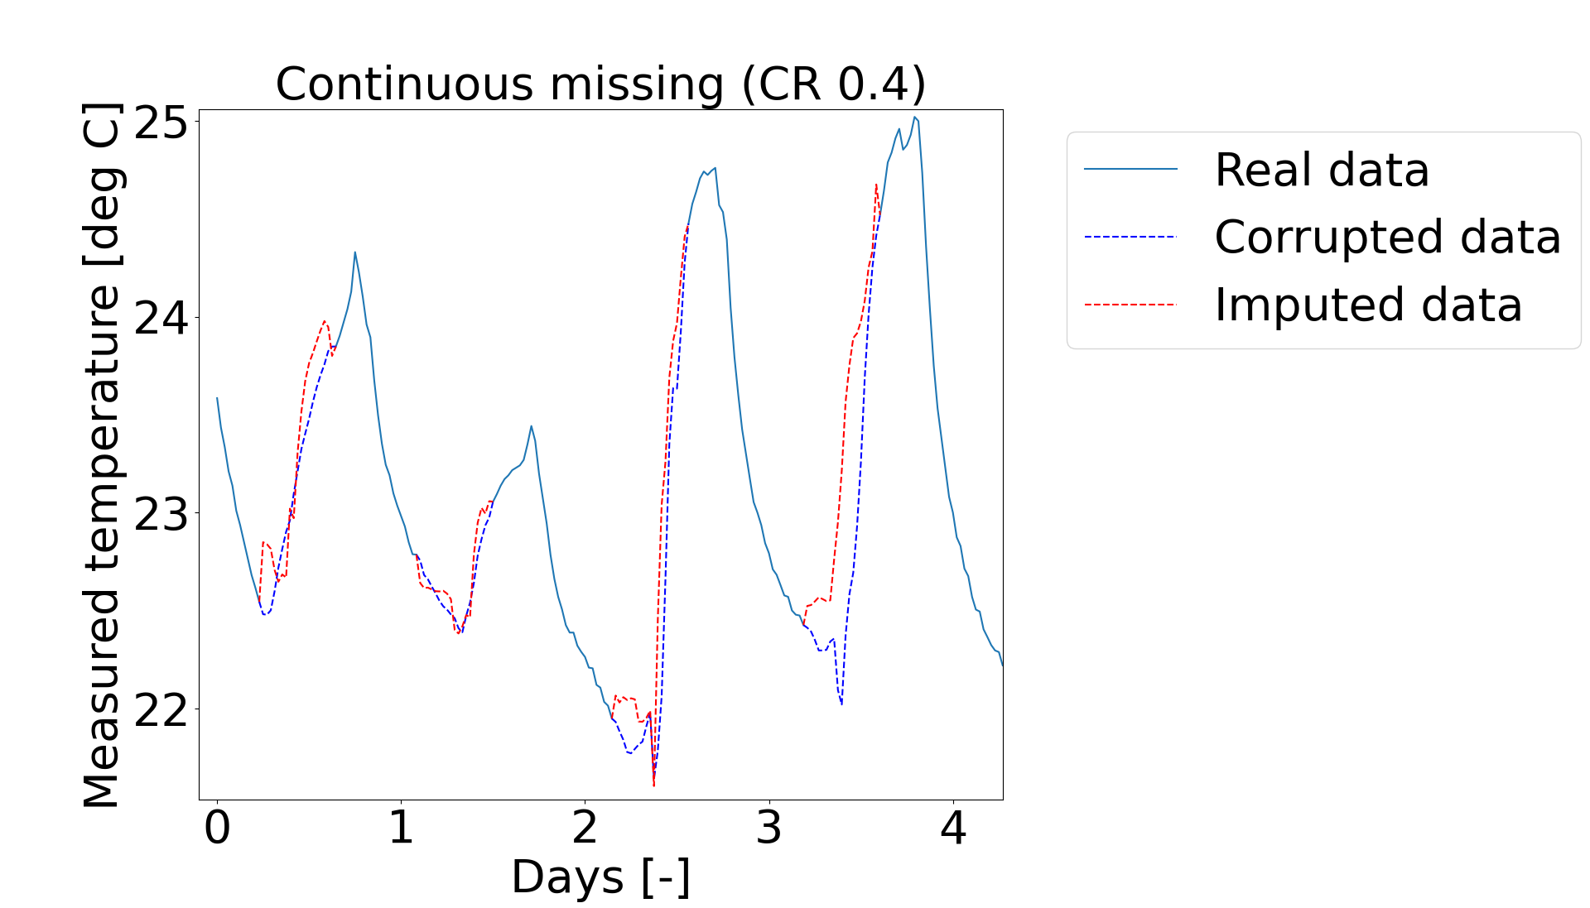
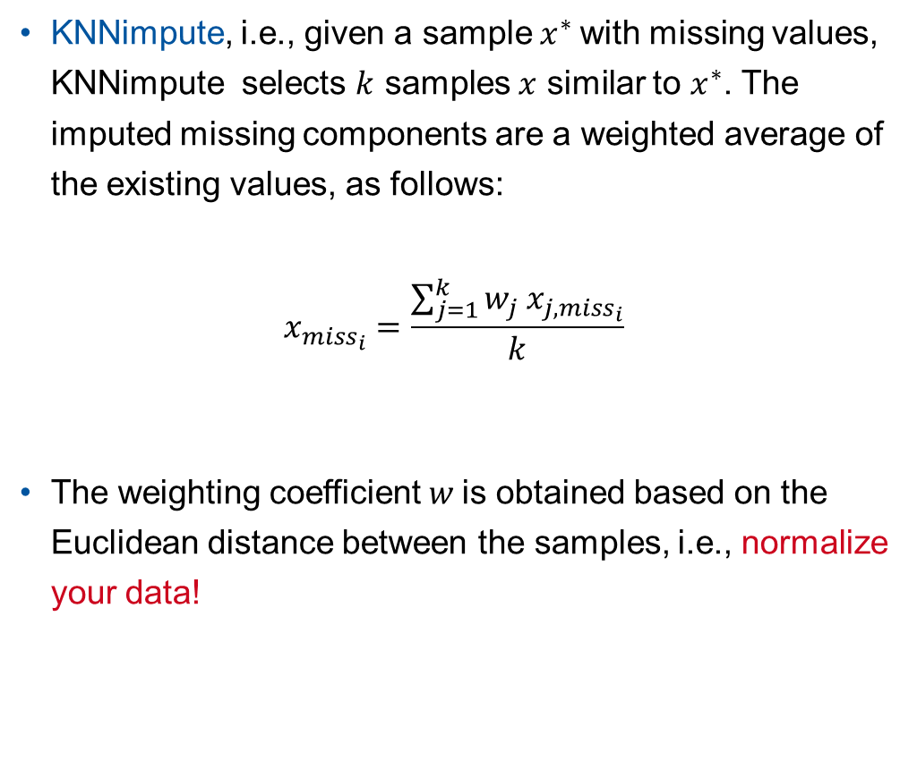
Imputation techniques - KNNimpute
KNNimpute, i.e., given a sample $x^{∗}$with missing values, KNNimpute selects $k$ samples $x$ similar to $x^{∗}$. The imputed missing components are a weighted average of the existing values, as follows:
$$x_{miss_{i}}=\frac{\sum_{j=1}^{k}{w_{j} x_{j, miss_{i}}}}{k}$$
The weighting coefficient $w$is obtained based on the Euclidean distance between the samples, i.e., normalize your data!
Fig. 6. Imputation with KNNimpute.

Slide 14








Imputation techniques - MissForest
A Random Forest regressor is an ensemble method that generates multiple decision trees / estimators to make a final prediction
Each decision tree is built independently on a randomly selected subset of features and training samples
Fig. 7. Figurative representation of a Random Forest. Each decision tree is built independently.

Slide 15
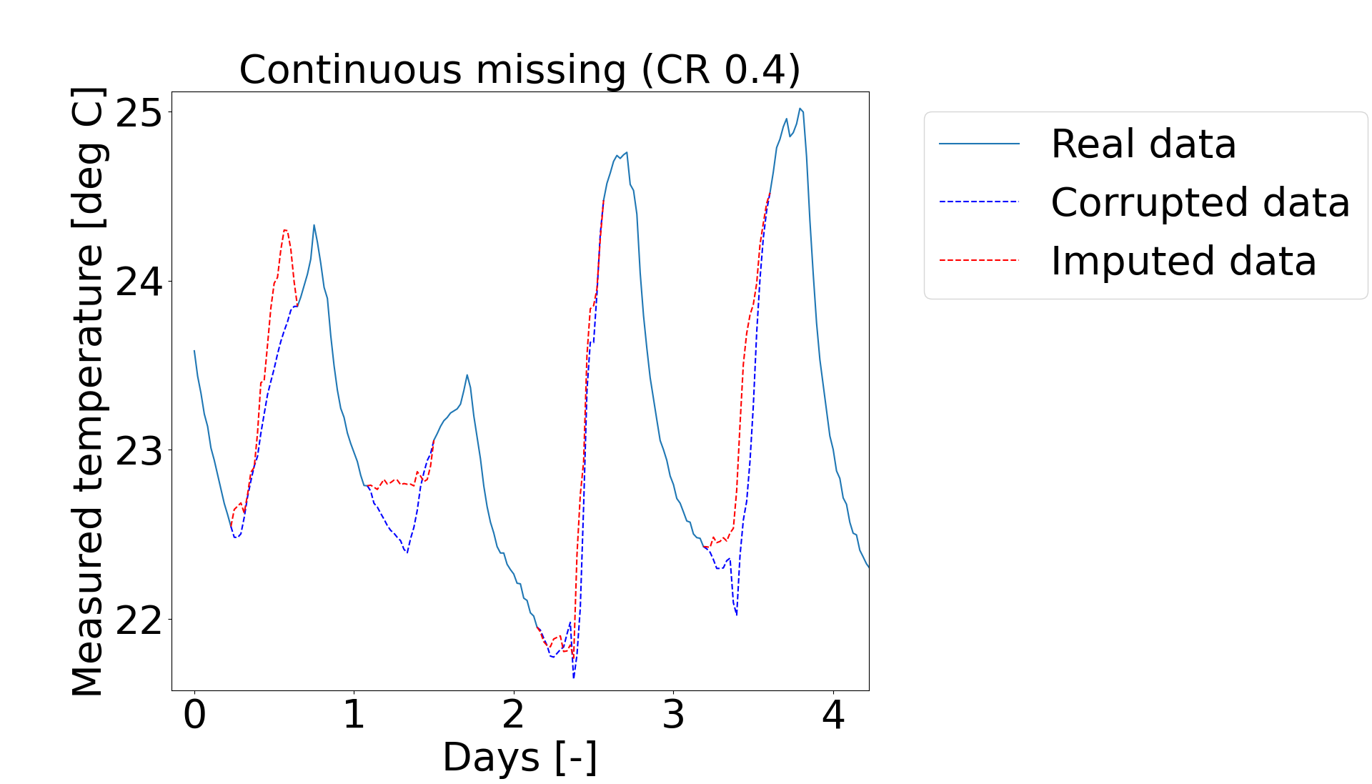
Imputation techniques - MissForest
MissForest, i.e., given a specific input feature, MissForest builds a Random Forest regressor to iteratively predict missing values based on the real and imputed values of the remaining features
Fig. 8. Imputation with MissForest.

